Slide 1

Sales and Profit Dashboard
Executive Overview
Analysis of Sales, Profit, and Customer Metrics (2021–2024)
Analysis conducted using Microsoft Excel (Pivot Tables & Charts)
SUPRATIM MAITY

Slide 2


Data Cleaning
For insight generation and dashboard visualization, two new columns were created in Excel:
Month
Year
These were extracted from the Order Date column using the following Excel formulas:
Month: =TEXT([@[Order Date]],"mmm")
Year: =[@Year]
This allowed time-based analysis in pivot tables (e.g., Sales by Month and Profit by Year), improving trend visibility and seasonal insights.

Slide 3

Business Performance Overview
$1.9M
$248K
Total Sales
Total Profit
Strong performance across four years
Healthy margins with room for optimization
Key Focus: Prioritize high-profit categories (Technology and Office Supplies) whilst evaluating Furniture pricing strategy.

Slide 4
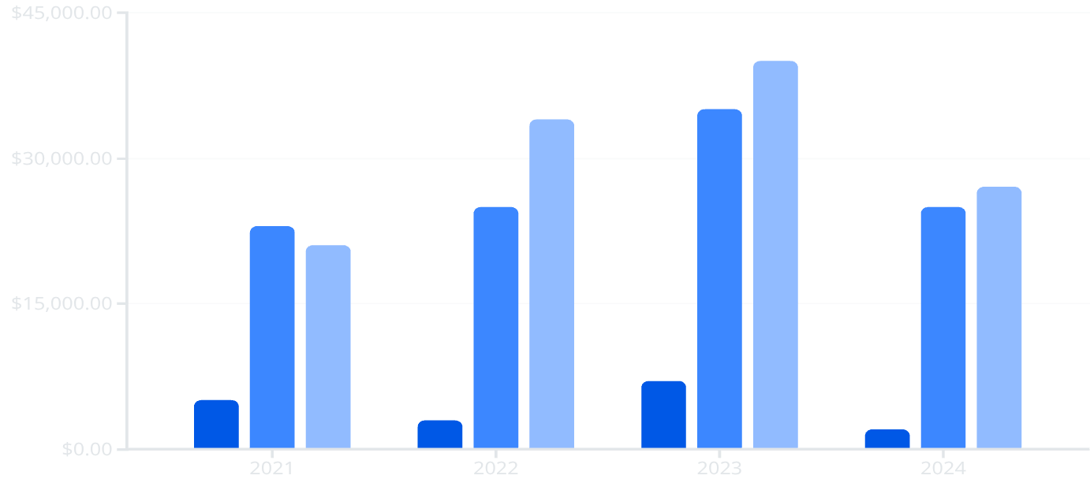
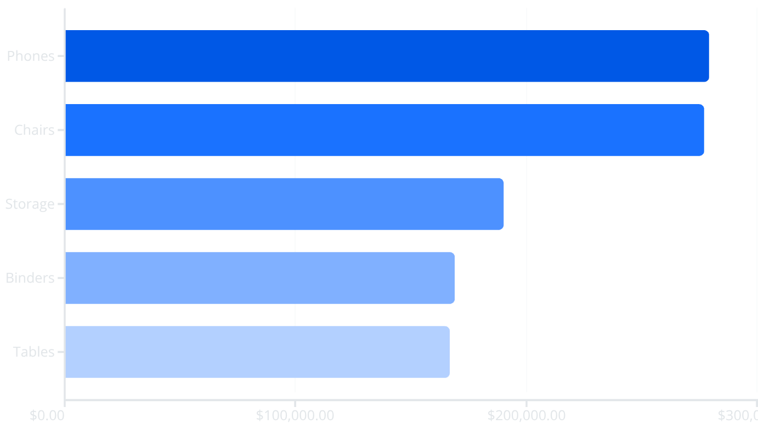

Profit Trends & Top Categories
Profit by Year
Sales by Category
Furniture
Office Supplies
Technology
Insight: 2023 peaked at $82K profit. 2024 dip requires investigation—likely cost pressure or reduced sales.
Recommendation: Prioritise inventory and marketing for top 5 categories. Phase out subcategories under $20K sales.

Slide 5

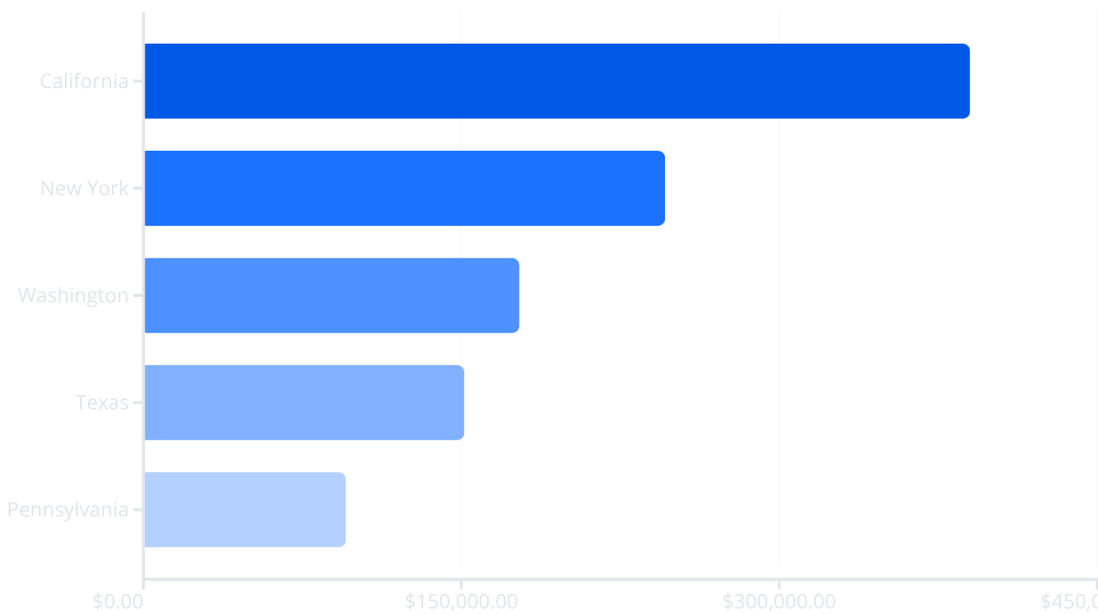
Customer Metrics & Geography
Customer Count by Year
Top 5 States by Sales
2021
2022
2023
2024
Critical Alert: 20% customer drop in 2024 indicates churn. Launch loyalty incentives immediately.
Opportunity: California dominates with 20% of sales. Expand regional marketing to midwestern and southern states.

Slide 6
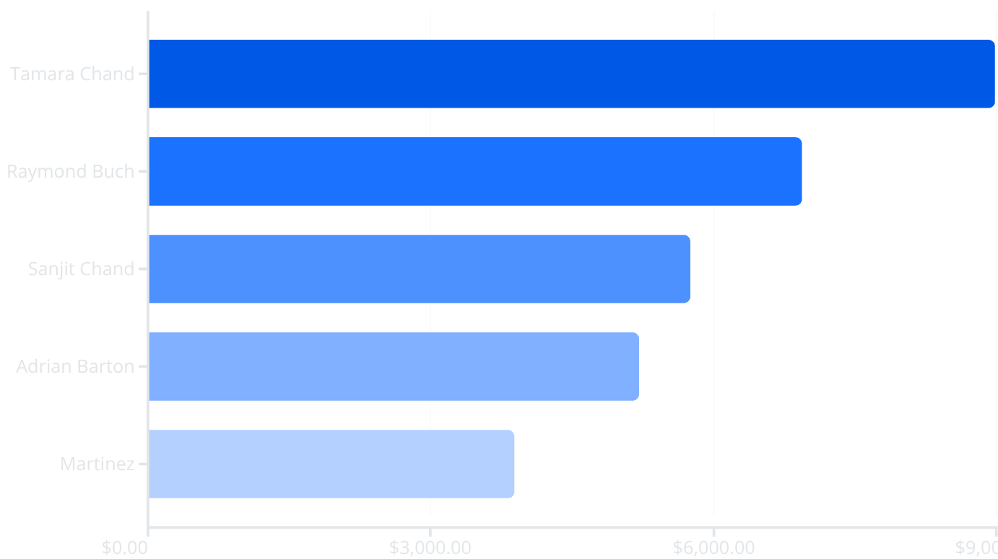
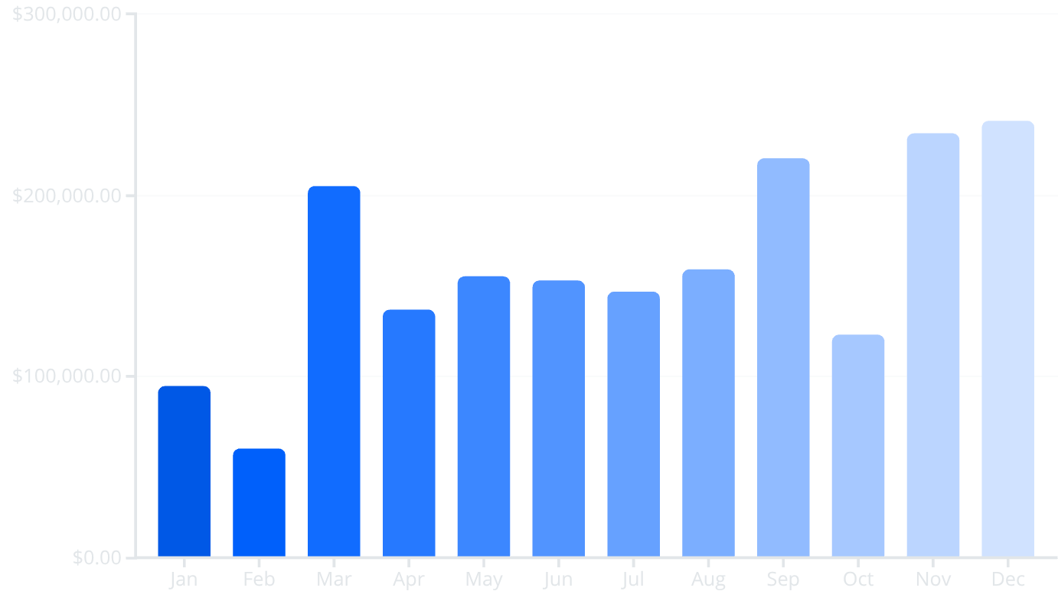
Profitability & Seasonality
Top 5 Customer Profit
Sales by Month
Risk Alert: Top 5 customers contribute 12% of profit. Diversify profit sources whilst strengthening key relationships.
Strategy: Strong Q2 and Q4 performance. Optimise inventory for high-demand periods; boost campaigns in Feb and Oct.

Slide 7




Short-Term Action Plan
Boost Retention
Launch loyalty rewards and feedback loops immediately
Focus Advertising
Concentrate on top 5 product categories
Reassess Portfolio
Discontinue or improve low-margin items

Slide 8




Long-Term Strategic Vision
Pricing Optimization
Predictive Analytics
Develop data-driven pricing models for margin improvement
Geographic Expansion
Invest in demand forecasting and inventory optimization tools
Expand presence in underperforming midwestern and southern states

Slide 9

Key Takeaways
2023 was the best-performing year across all metrics.
Technology and California drive most business growth.
Customer churn in 2024 is a major concern.
Seasonal trends should inform inventory and staffing decisions

Slide 10
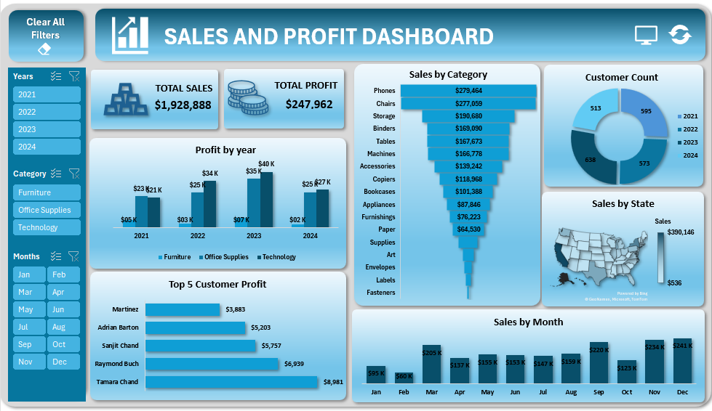

Slide 11
THANK YOU

